Slide 1
Classes
Lecture # 13
Inheritance

Slide 2
Modes of Inheritance
Public mode: If we derive a sub class from a public base class. Then the public member of the base class will become public in the derived class and protected members of the base class will become protected in derived class.
Protected mode: If we derive a sub class from a Protected base class. Then both public member and protected members of the base class will become protected in derived class.
Private mode: If we derive a sub class from a Private base class. Then both public member and protected members of the base class will become Private in derived class.

Slide 3

The private members in the base class cannot be directly accessed in the derived class, while protected members can be directly accessed.

Slide 4
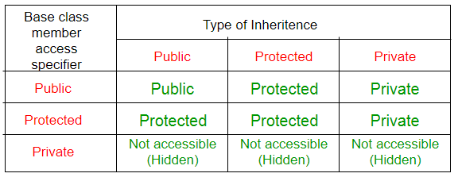

Slide 5
Multilevel Inheritance
In this type of inheritance, a derived class is created from another derived class.

Slide 6
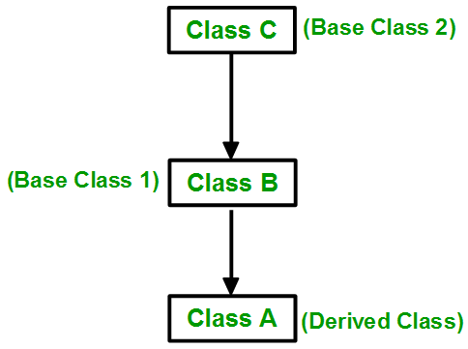

Slide 7
Multiple Inheritance
Multiple Inheritance is a feature of C++ where a class can inherit from more than one classes. i.e one sub class is inherited from more than one base classes.
The derived class are allowed to use the joint features of the inherited base classes.

Slide 8
class subclass_name : access_mode base_class1, access_mode base_class2, ....
{
//body of subclass
};

Slide 9

Multiple Inheritance

Slide 10
1. | Single inheritance is one in which the derived class inherits the single base class. | Whereas multiple inheritance is one in which the derived class acquires two or more base classes.
2. | In single inheritance, the derived class uses the features of the single base class. | While in multiple inheritance, the derived class uses the joint features of the inherited base classes.
3. | Single inheritance requires small run time as compared to multiple inheritance due to less overhead. | While multiple inheritance requires more run time time as compared to single inheritance due to more overhead.
4. | Single inheritance is a lot of close to specialization. | In contrast, multiple inheritance is a lot of close to generalization.
5. | Single inheritance is implemented as Class DerivedClass_name : access_specifier Base_Class{};. | While multiple inheritance is implemented as Class DerivedClass_name : access_specifier Base_Class1, access_specifier Base_Class2, ….{}; .
6. | Single inheritance is simple in comparison to the multiple inheritance. | While multiple inheritance is complex in comparison to the single inheritance.
7. | Single inheritance can be implemented in any programming language. | C++ supports multiple inheritance but multiple inheritance can’t be implemented in any programming language(C#, Java doesn’t support multiple inheritance).

Slide 11
Hierarchical Inheritance
In this type of inheritance, more than one sub class is inherited from a single base class. i.e. more than one derived class is created from a single base class.

Slide 12
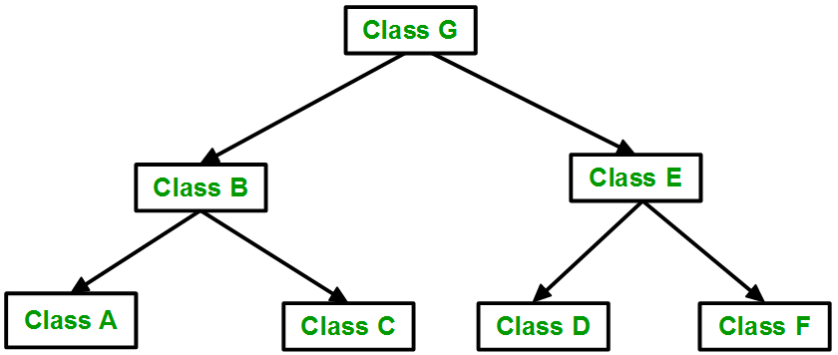

Slide 13
Hybrid Inheritance
Hybrid Inheritance is implemented by combining more than one type of inheritance. For example: Combining Hierarchical inheritance and Multiple Inheritance.

Slide 14
